Slide 1
Used car price prediction project
Aim is to develop a new machine learning model to predict used car prices with respect to the current market conditions.

Slide 2
Business problem
With the covid 19 impact in the market, we have seen lot of changes in the car market. Now some cars are in demand hence making them costly and some are not in demand hence cheaper.
With the change in market due to covid 19 impact, the previous car price valuation machine learning models may not provide accurate predictions.
We have to make car price valuation model that can predict used car prices with respect to current market conditions by acquiring used car prices from websites.
This project consists of two phases 1) Scraping used car prices from websites and 2) Model building phase.
In this project, I have scraped used car data from cars24.

Slide 3
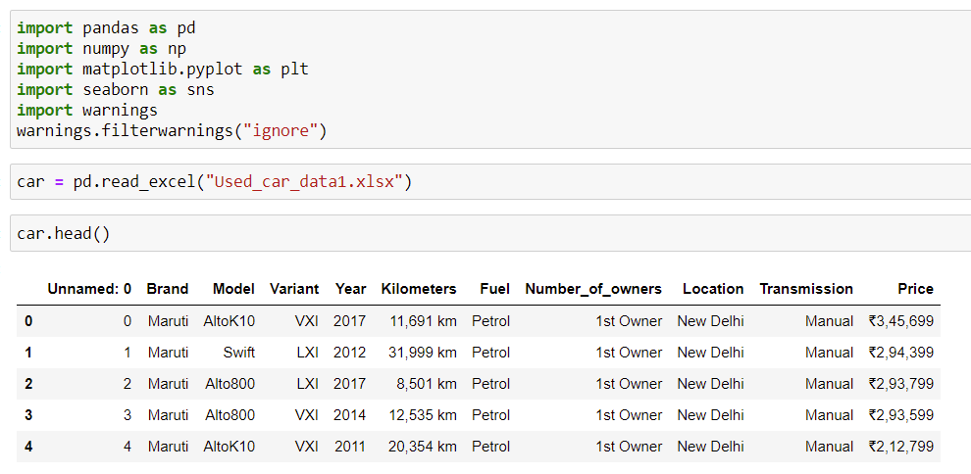
Understanding data
We will now import the scraped data and understand the data.
Price would be our target
column. We will need to
clean price and kilometres
columns.

Slide 4
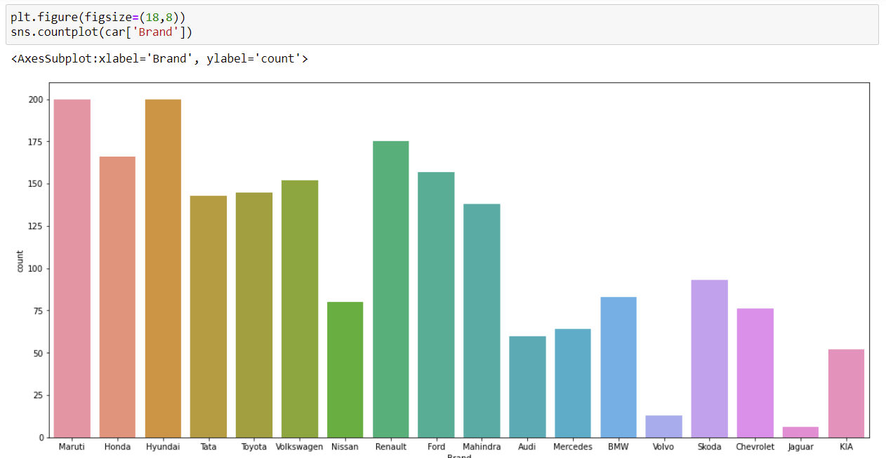
This plot gives us understanding of the car company names that we scraped data from.

Slide 5
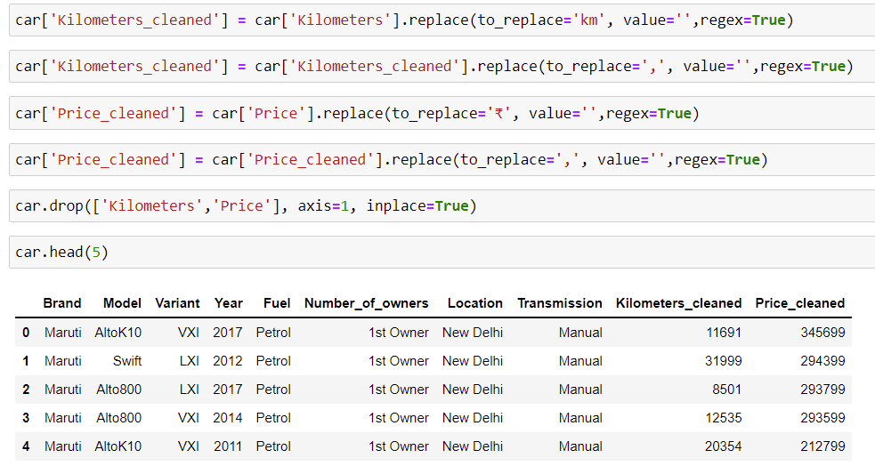
We cleaned the Price and Kilometers columns and dropped the columns.

Slide 6
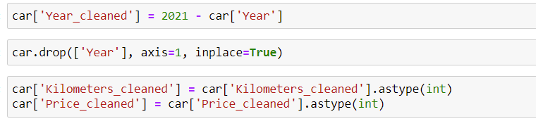
We also year of cars to age of the cars by subtracting the column with 2021 and dropped them.
Also made sure that the datatype is in integers.
We will now try to slightly understand the data and move forward to create an ML model.

Slide 7
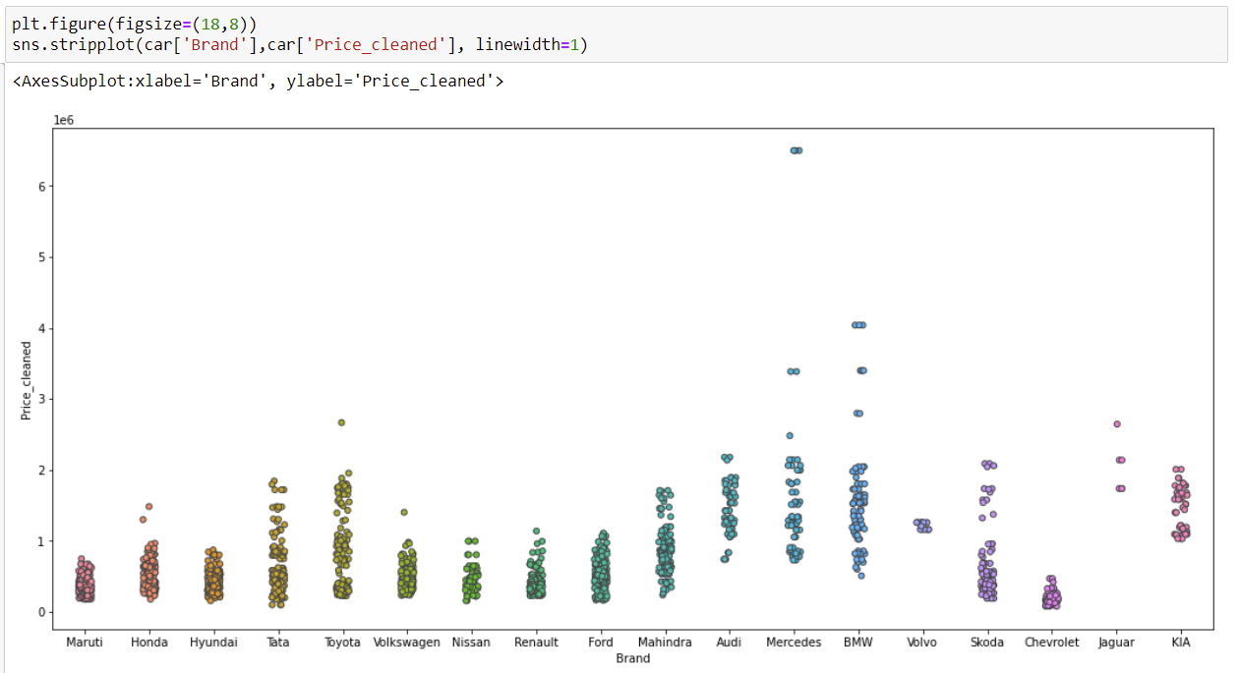
We can see Maruti have a low used car price and the highest would be Audi, Benz and BMW cars.

Slide 8
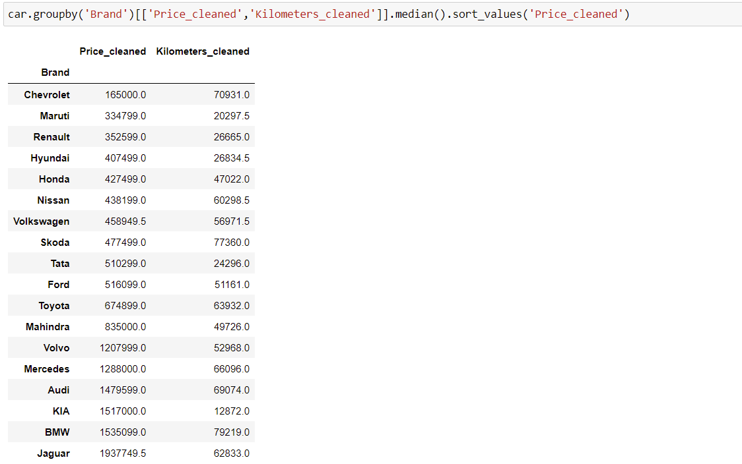
From above, we can observe that Chevrolet, Maruti, Renault have lowest price point. However, we haven't included the year aspect yet.

Slide 9
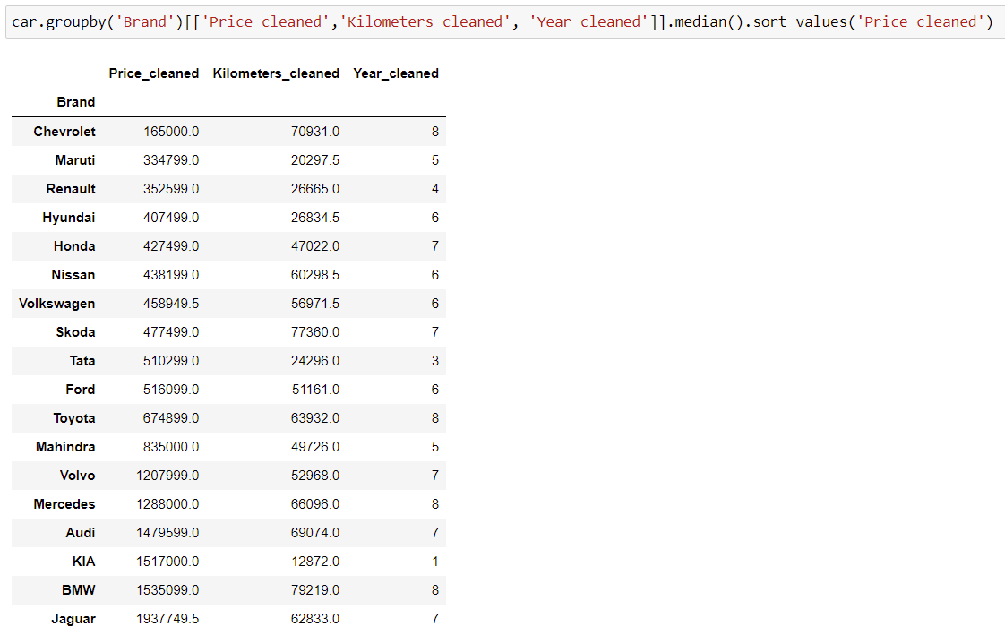
Out of this observation Tata would provide a better used car experience as the normal age of car would be 3 years and 510299 would also be a good price point to consider.

Slide 10
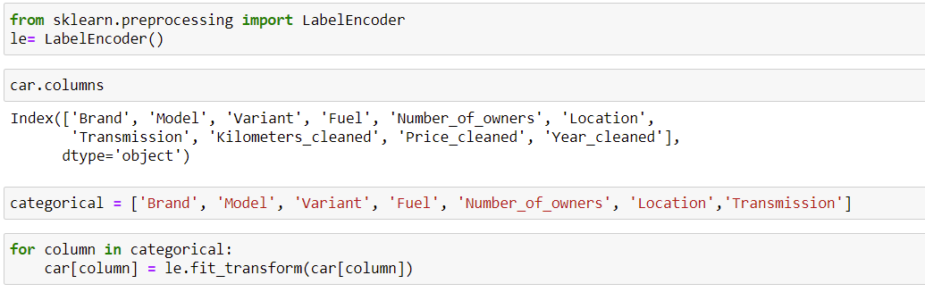
We will now encode categorical columns so that we can pass them through ML Algorithms. We will use LabelEncoder.
We have now encoded the categorical columns we will now divide the data into independent and dependent parts.

Slide 11
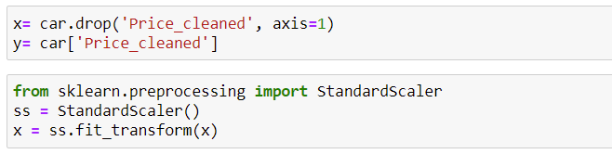
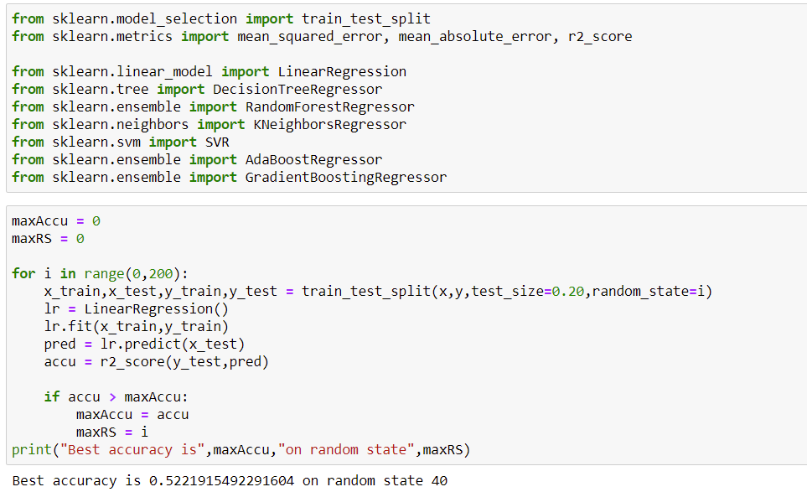

Slide 12
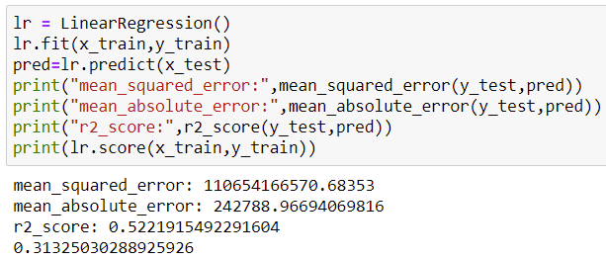
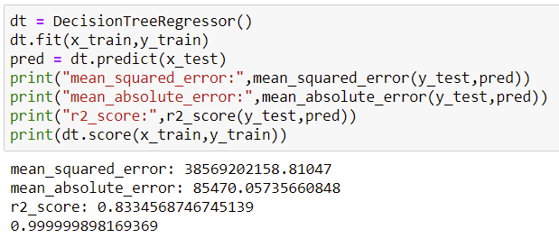
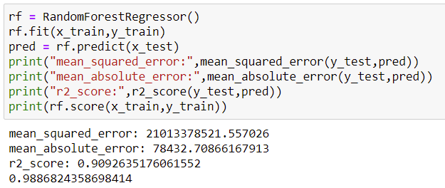
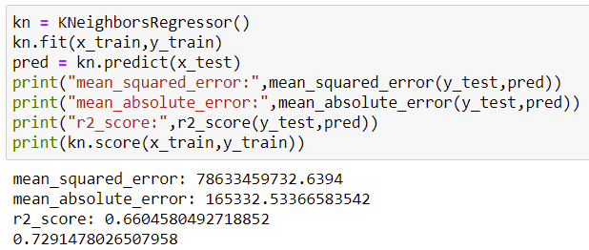
We used standard scaler to scale the data and imported all the necessary algorithms to create a model.

Slide 13
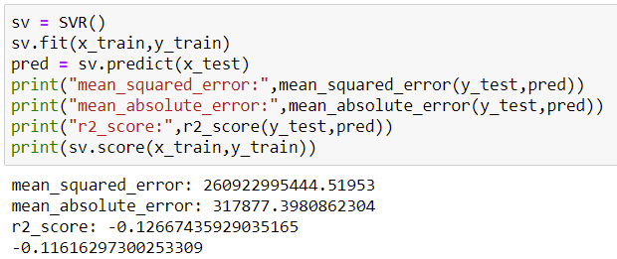
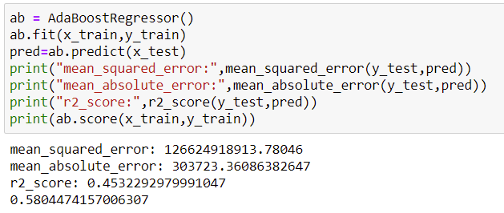
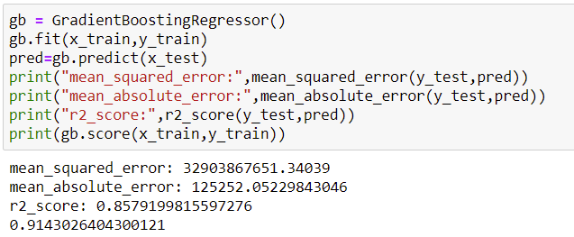
DecisionTreeRegressor, RandomForestRegressor and GradientBoostingRegressor performed well. However, we will cross validate.

Slide 14
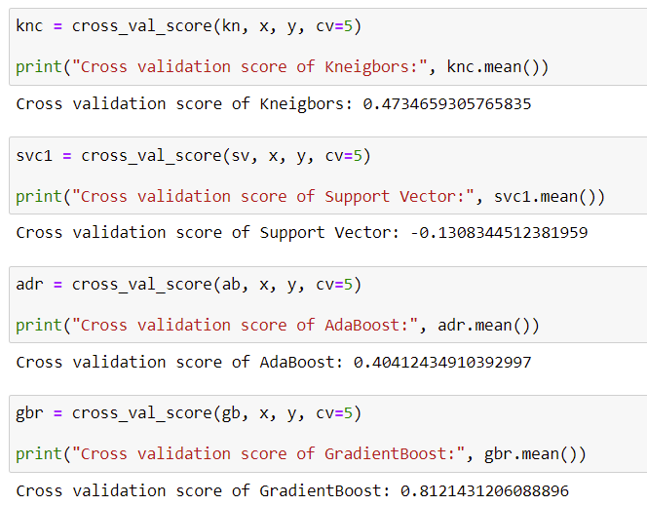
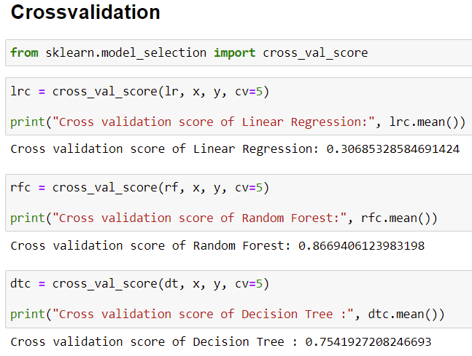
We will perform HyperParameterTuning and create two model with RandomForest and Gradient Boosting Regression and select the best out of the two model.

Slide 15
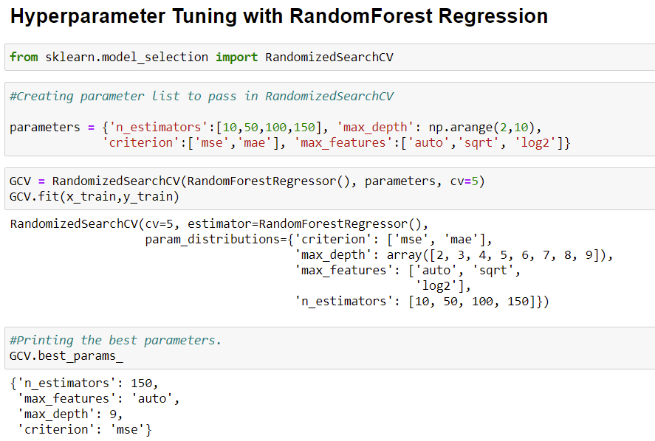
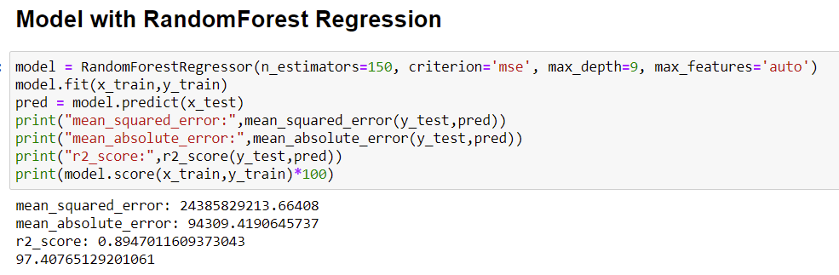

Slide 16
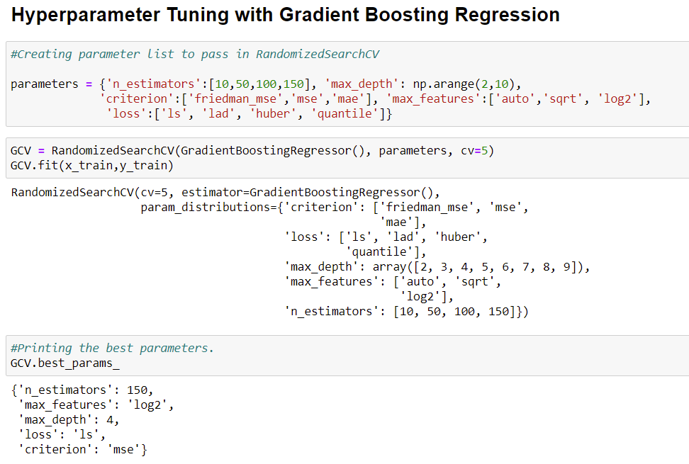
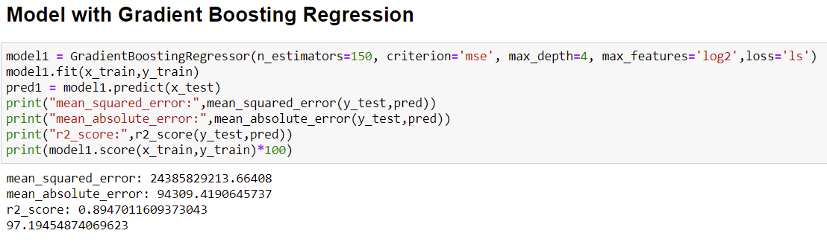
Both model performed well and output are same. We will save model with random forest.

Slide 17
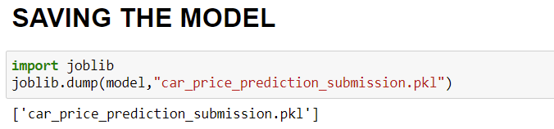
Saving the model

Slide 18
conclusion
Key Findings and Conclusions of the Study
If a car has less age and have run less kilometres, the price would be on higher side. The transmission, fuel type, location, variant and brand also equally important.
This study would help us understand which brand cars with certain a range of kilometres variant and other aspects to focus on so that we can create a better business model and take necessary steps to move forward.

Slide 19
THANKS TO:
Mentor/SME @ FlipRobo Technologies, Mr. Sajid Choudhary
DataScientists and mentors at DataTrained Institute.
ALSO TOOK HELP FROM:
Kaggle.
Stack Over Flow.
Towards Data Science.
PRESENTED BY:
Pawar Vinay Prasad (Data science Intern @ FlipRobo Technologies).

